Slide 1
DATABASE MANAGEMENT SYSTEM CAPSTONE PROJECT
GYM MEMBERSHIP MANAGEMENT
SYSTEM
Presented by:
M Praneeth 25B11CS587
L V Nitheesh Patrudu 25B11CS515
D Mahesh Babu 25B11CS215
Nava Jeevan 25B11CS969

Slide 2
Presentation Outline
Project Overview
Problem Statement
Objectives
Requirements
System Modules
Database Entities
Relationships & Cardinality
ER Diagram
Database Implementation
SQL Queries
Results & Benefits
Conclusion & Future Scope

Slide 3

Project Overview
The Gym Membership Management System is a database system designed to manage important gym-related information in an organized manner.
The system manages:
Members
Trainers
Membership Plans
Memberships
Payments
Attendance
Technology Used
Database: Oracle Database
Language: SQL
Environment: Oracle SQL Developer
Key Point: The system stores related gym information in multiple relational tables connected using Primary Keys and Foreign Keys.

Slide 4
Problem Statement & Objectives
Problem Statement
Objectives
Managing gym records manually can make it difficult to:
Store member information systematically
Manage trainers and their specializations
Maintain available membership plans
Track member memberships
Record payments for memberships
Maintain attendance records
Establish relationships between related data
Retrieve information using SQL queries
Maintain member information
Track active memberships
Manage different membership plans
Assign trainers
Maintain payment records
Track attendance
Retrieve information efficiently

Slide 5
Requirements
Functional Requirements:
Member & Trainer Management — Stores and manages member and trainer details.
Membership Management — Assigns plans and trainers to members and tracks membership dates/status.
Plan Management — Stores plan duration and fee.
Payment Management — Records payments made for memberships.
Attendance Management — Records member attendance date and status.
Data Retrieval — Retrieves related information using SQL queries and JOINs.
Non-Functional Requirements:
Performance — Provides quick data retrieval.
Accuracy — Maintains correct and consistent records.
Security — Protects database information.
Reliability — Ensures dependable data storage.
Maintainability — Makes the database easy to update and manage.

Slide 6
System Modules
Members
Trainers
Membership Plans
Stores member information such as:
Stores:
Stores:
Member ID
Name
Age
Gender
Phone
Join Date
Trainer ID
Trainer Name
Specialization
Phone
Plan ID
Plan Name
Duration
Fee
Memberships
Payments
Attendance
Connects members with plans and trainers and stores membership dates and status.
Stores payment information related to memberships.
Stores member attendance date and status.

Slide 7
Database Entities & Attributes
Entity
Primary Key
Foreign Key
Attributes
MEMBERS
member_id
—
name, age, gender, phone, join_date
TRAINERS
trainer_id
—
trainer_name, specialization, phone
MEMBERSHIP_PLANS
plan_id
—
plan_name, duration_months, fee
MEMBERSHIPS
membership_id
member_id, plan_id, trainer_id
start_date, end_date, status
PAYMENTS
payment_id
membership_id
amount, payment_date, payment_method
ATTENDANCE
—
member_id
attendance_date, status

Slide 8
Relationships & Cardinality
Members — Memberships
Membership_Plans — Memberships
Trainers — Memberships
Cardinality: 1 : M
One member can have many memberships. Each membership belongs to one member.
Members.member_id → Memberships.member_id
Cardinality: 1 : M
One trainer can be assigned to many memberships. A membership can have zero or one trainer because trainer_id is nullable.
Trainers.trainer_id → Memberships.trainer_id
Cardinality: 1 : M
One membership plan can be used by many memberships. Each membership belongs to one plan.
Membership_Plans.plan_id → Memberships.plan_id
Memberships — Payments
Members — Attendance
Cardinality: 1 : M
One membership can have many payments. Each payment belongs to one membership.
Memberships.membership_id → Payments.membership_id
Cardinality: 1 : M
One member can have many attendance records. Each attendance record belongs to one member.
Members.member_id → Attendance.member_id

Slide 9
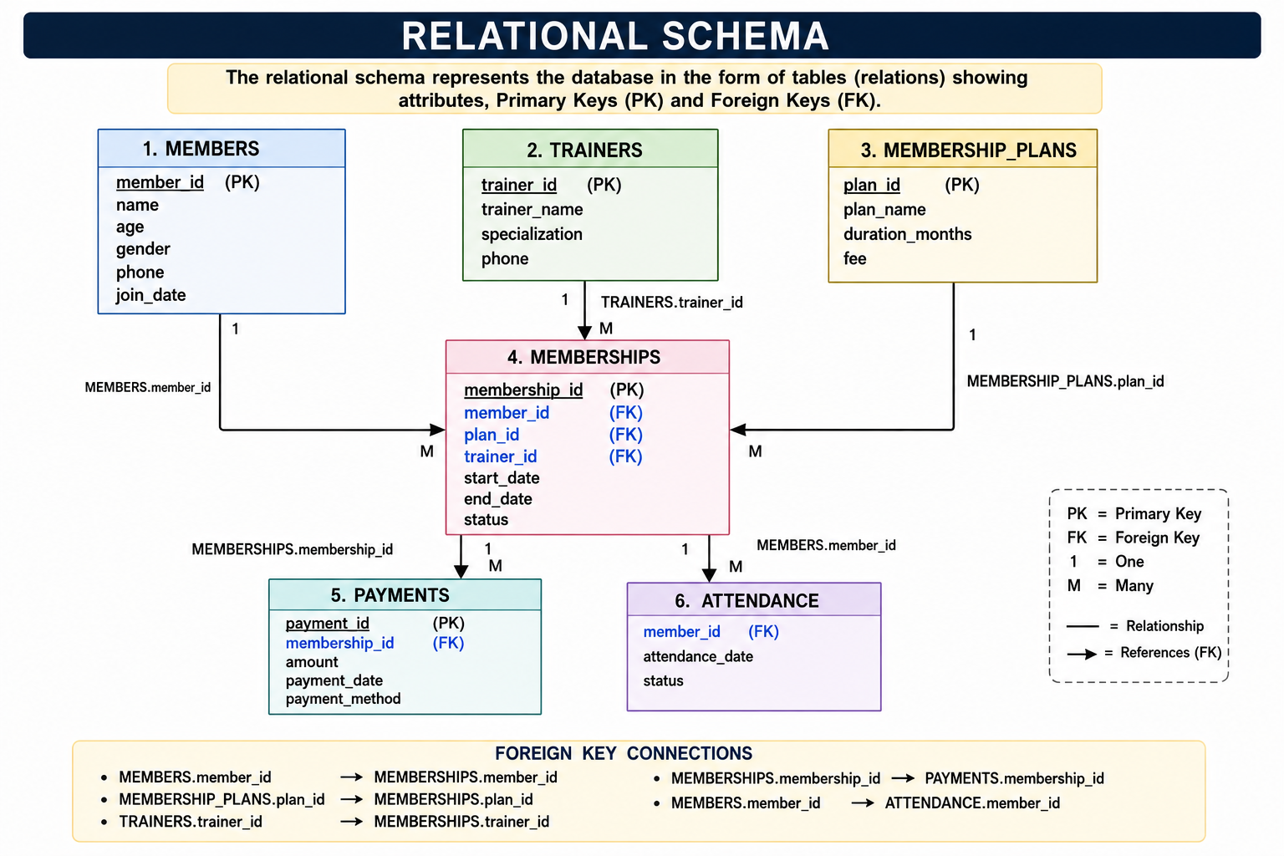
Relational Schema:
SQL Queries:
Benefits:
The system can retrieve information such as:
Organized data management
Reduced data redundancy
Faster information retrieval
Better data consistency
Easy maintenance
Clear relationships between records
Member details
Membership details
Membership plan details
Trainer assignments
Payment information
Attendance information
Join Queries:
JOINs allow information from related tables to be combined.
For example:
Members + Memberships + Membership_Plans
can be used to display:
Member name
Membership Plan name
Start date
End date
Status

Slide 10
DATABASE MANAGEMENT SYSTEM CAPSTONE PROJECT
GYM MEMBERSHIP MANAGEMENT
SYSTEM
Review-2
Presented by:
M Praneeth 25B11CS587
L V Nitheesh Patrudu 25B11CS515
D Mahesh Babu 25B11CS215
Nava Jeevan 25B11CS969

Slide 11
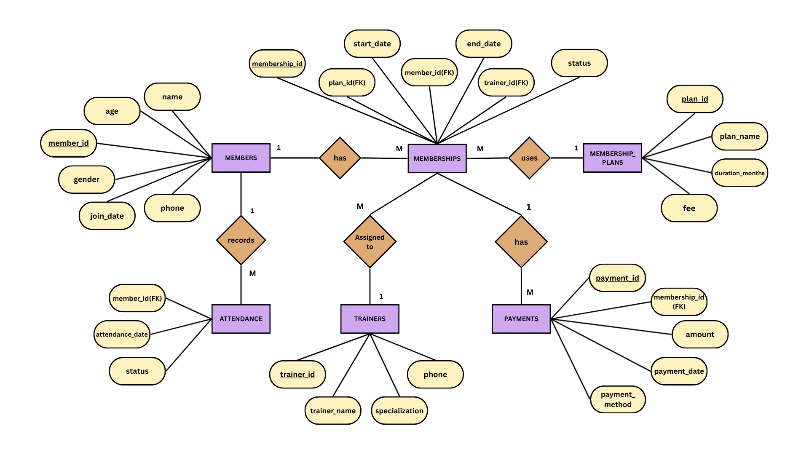
Complete ER Diagram

Slide 12
Table Creation
The ER model into six relational tables using Oracle SQL. Each table contains attributes relevant to that entity.
Table 1: Members
CREATE TABLE Members (
member_id NUMBER PRIMARY KEY,
name VARCHAR2(50) NOT NULL,
age NUMBER,
gender VARCHAR2(10),
phone VARCHAR2(15) UNIQUE,
join_date DATE NOT NULL
);
Table 2: Trainers
CREATE TABLE Trainers (
trainer_id NUMBER PRIMARY KEY,
trainer_name VARCHAR2(50) NOT NULL,
specialization VARCHAR2(50),
phone VARCHAR2(15)
);

Slide 13
Table 3: Membership_Plans
CREATE TABLE Membership_Plans (
plan_id NUMBER PRIMARY KEY,
plan_name VARCHAR2(50) NOT NULL,
duration_months NUMBER NOT NULL,
fee NUMBER(10,2) NOT NULL
);
Table 4: Memberships
CREATE TABLE Memberships (
membership_id NUMBER PRIMARY KEY,
member_id NUMBER,
plan_id NUMBER,
trainer_id NUMBER,
start_date DATE NOT NULL,
end_date DATE NOT NULL,
status VARCHAR2(20) NOT NULL,
FOREIGN KEY (member_id) REFERENCES Members(member_id),
FOREIGN KEY (plan_id) REFERENCES Membership_Plans(plan_id),
FOREIGN KEY (trainer_id) REFERENCES Trainers(trainer_id)
);

Slide 14
Table 5: Payments
CREATE TABLE Payments (
payment_id NUMBER PRIMARY KEY,
membership_id NUMBER,
payment_date DATE NOT NULL,
amount NUMBER(10,2) NOT NULL,
payment_method VARCHAR2(20),
FOREIGN KEY (membership_id) REFERENCES Memberships(membership_id)
);
Table 6: Attendance
CREATE TABLE Attendance (
attendance_id NUMBER PRIMARY KEY,
member_id NUMBER,
attendance_date DATE NOT NULL,
status VARCHAR2(15) NOT NULL,
FOREIGN KEY (member_id) REFERENCES Members(member_id)
);

Slide 15
Keys & Constraints
Primary Keys
Members → member_id
Trainers → trainer_id
Membership_Plans → plan_id
Memberships → membership_id
Payments → payment_id
Attendance → attendance_id
Foreign Keys
Memberships → member_id
Memberships → plan_id
Memberships → trainer_id
Payments → membership_id
Attendance → member_id
Constraints
PRIMARY KEY
FOREIGN KEY
NOT NULL
UNIQUE
Purpose
Entity integrity
Referential integrity
Prevention of invalid/duplicate data

Slide 16
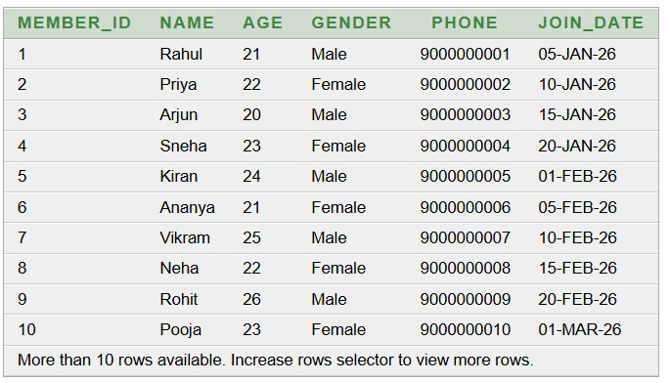
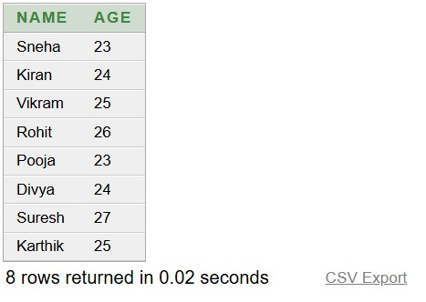
Basic Queries:
Basic Query 1 — SELECT
Display all the members registered in the gym.
SELECT * FROM Members;
Basic Query 2 — Members above 22
"Display members whose age is greater than 22."
SELECT name, age
FROM Members
WHERE age > 22;
Output:
Output:

Slide 17
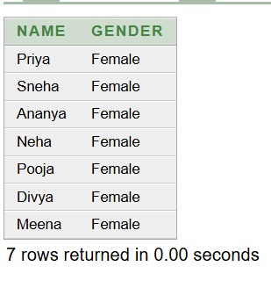
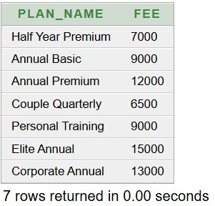
Basic Queries:
Basic Query 3 — Female members
This query displays only members whose gender is Female.
SELECT name, gender
FROM Members
WHERE gender = 'Female';
Basic Query 4 — Plans above ₹5,000
SELECT plan_name, fee
FROM Membership_Plans
WHERE fee > 5000;
Output:
Output:

Slide 18
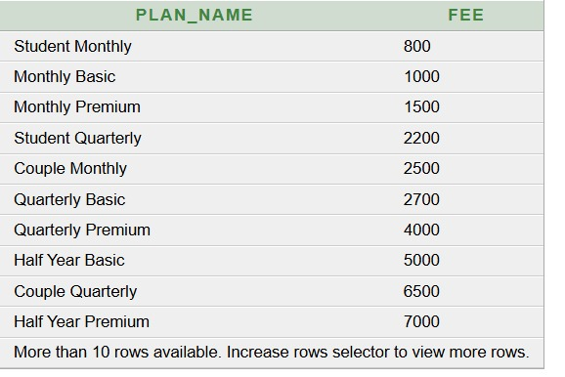

Basic Queries:
Basic Query 5 — Sort plans by fee
SELECT plan_name, fee
FROM Membership_Plans
ORDER BY fee ASC;
Basic Query 6 — Average membership fee
SELECT AVG(fee) AS average_fee
FROM Membership_Plans;
Output:
Output:

Slide 19
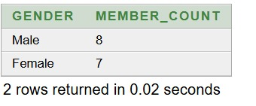
Basic Queries:
Basic Query 7 — Count members by gender
SELECT gender, COUNT(*) AS member_count
FROM Members
GROUP BY gender;
Output:

Slide 20
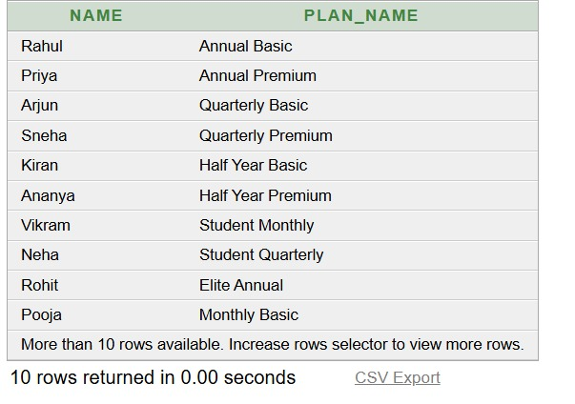
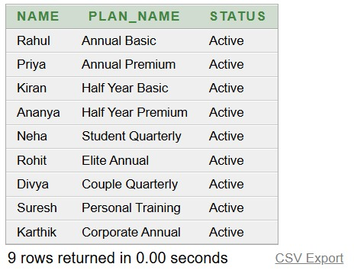
Advanced Queries:
Query 8 — Display members with their membership plans
SELECT m.name, p.plan_name
FROM Members m
JOIN Memberships ms
ON m.member_id = ms.member_id
JOIN Membership_Plans p
ON ms.plan_id = p.plan_id;
Query 9 — Display active members and their plans
SELECT m.name, p.plan_name, ms.status
FROM Members m
JOIN Memberships ms
ON m.member_id = ms.member_id
JOIN Membership_Plans p
ON ms.plan_id = p.plan_id
WHERE ms.status = 'Active';
Output:
Output:

Slide 21
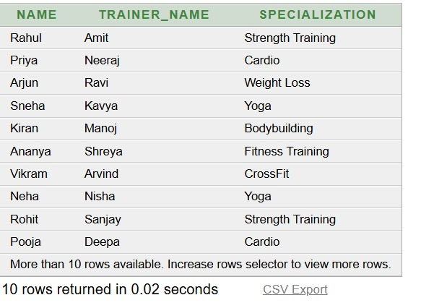

Advanced Queries:
Query 10 — Display members with their trainers
SELECT m.name, t.trainer_name, t.specialization
FROM Members m
JOIN Memberships ms
ON m.member_id = ms.member_id
JOIN Trainers t
ON ms.trainer_id = t.trainer_id;
Query 11 — Find trainers assigned to more than one member
SELECT t.trainer_name, COUNT(ms.member_id) AS member_count
FROM Trainers t
JOIN Memberships ms
ON t.trainer_id = ms.trainer_id
GROUP BY t.trainer_name
HAVING COUNT(ms.member_id) > 1;
Output:
Output:

Slide 22
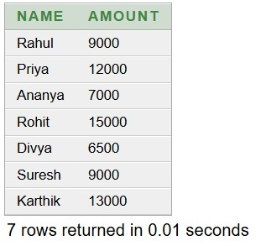
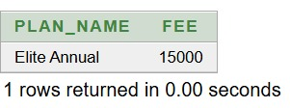
Advanced Queries:
Query 12 — Find members paying more than the average payment
SELECT m.name, p.amount
FROM Members m
JOIN Memberships ms
ON m.member_id = ms.member_id
JOIN Payments p
ON ms.membership_id = p.membership_id
WHERE p.amount > (
SELECT AVG(amount)
FROM Payments
);
Query 13 — Find the highest membership fee.
SELECT plan_name, fee
FROM Membership_Plans
WHERE fee = (
SELECT MAX(fee)
FROM Membership_Plans
);
Output:
Output:

Slide 23
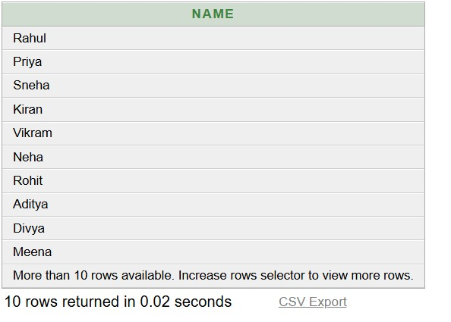
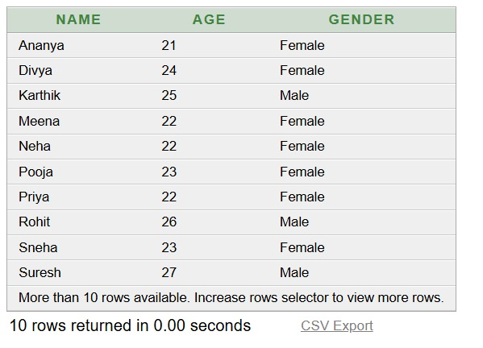
Advanced Queries:
Query 14 — Display members who attended the gym
SELECT name
FROM Members
WHERE member_id IN (
SELECT member_id
FROM Attendance
WHERE status = 'Present'
);
Query 15 — Combine members with age above 24 and female members
SELECT name, age, gender
FROM Members
WHERE age > 24
UNION
SELECT name, age, gender
FROM Members
WHERE gender = 'Female';
Output:
Output:

Slide 24



Why Normalize the Gym Database?
One big table repeats member, plan and trainer details again and again. That causes three anomalies:
Update anomaly
Insert anomaly
Delete anomaly
Ravi's specialization is saved on many rows. Change one row and the data contradicts itself.
A new trainer or plan cannot be saved until a member is linked to it.
Deleting a member's last record also wipes out the plan and trainer details stored with it.
Goal 1
Goal 2
Avoid data redundancy
Maintain data integrity
Store every fact exactly once.
Keep data accurate and consistent with keys.
Notes:
Explain the three anomalies with gym examples, then state the two goals of normalization: remove redundancy and protect integrity.

Slide 25
1NF Before: Repeating Groups
1NF rule: every cell holds a single atomic value and there are no repeating groups.
Gym_Records (unnormalized, no clear key)
member_id | name | plan_id | plan_name | fee | trainer_id | trainer_name | specialization | payment_dates | amounts | attendance_dates
101 | Arun | P1 | Premium | 6000 | T1 | Ravi | Strength Training | 05-Jan, 05-Feb | 3000, 3000 | 02-Jan, 03-Jan
102 | Meena | P2 | Basic | 3000 | T1 | Ravi | Strength Training | 10-Jan | 3000 | 04-Jan, 05-Jan
103 | Suresh | P1 | Premium | 6000 | T2 | Kiran | Yoga | 12-Jan, 12-Feb | 3000, 3000 | 06-Jan
Multi-valued cells (several values stored in one cell)
1
Multi-valued cells
2
Repeating groups
3
Hard to query
payment_dates, amounts and attendance_dates pack several values into one cell.
Each new payment or visit is added to the same row instead of a new row.
You cannot SUM amounts or COUNT visits per day with plain SQL.
Notes:
Point at the highlighted columns: several payments and attendance dates are crammed into single cells. This violates 1NF.

Slide 26
1NF After: Atomic Values
Each cell now holds one value. Payments become one row each and attendance moves to its own table.
Member_Payments PK: member_id + payment_date
member_id | name | plan_id | plan_name | fee | trainer_id | trainer_name | specialization | payment_date | amount
101 | Arun | P1 | Premium | 6000 | T1 | Ravi | Strength Training | 05-Jan | 3000
101 | Arun | P1 | Premium | 6000 | T1 | Ravi | Strength Training | 05-Feb | 3000
102 | Meena | P2 | Basic | 3000 | T1 | Ravi | Strength Training | 10-Jan | 3000
103 | Suresh | P1 | Premium | 6000 | T2 | Kiran | Yoga | 12-Jan | 3000
103 | Suresh | P1 | Premium | 6000 | T2 | Kiran | Yoga | 12-Feb | 3000
Attendance PK: member_id + attendance_date
payment_dates and amounts become one row per payment
attendance_dates move into a separate Attendance table
Composite key (member_id, payment_date) identifies each row
member_id | attendance_date
101 | 02-Jan
101 | 03-Jan
102 | 04-Jan
102 | 05-Jan
103 | 06-Jan
Still a problem: name, plan and trainer details repeat on every payment row. We fix this in 2NF.
Notes:
After 1NF every cell is atomic. The key is now a composite of member_id and payment_date. Notice the repeated member, plan and trainer details; that leads to 2NF.

Slide 27
2NF Before: Partial Dependency
2NF rule: be in 1NF, and every non-key column must depend on the whole primary key, not just part of it.
Member_Payments PK: member_id + payment_date
member_id | name | plan_id | plan_name | fee | trainer_id | trainer_name | specialization | payment_date | amount
101 | Arun | P1 | Premium | 6000 | T1 | Ravi | Strength Training | 05-Jan | 3000
101 | Arun | P1 | Premium | 6000 | T1 | Ravi | Strength Training | 05-Feb | 3000
102 | Meena | P2 | Basic | 3000 | T1 | Ravi | Strength Training | 10-Jan | 3000
103 | Suresh | P1 | Premium | 6000 | T2 | Kiran | Yoga | 12-Jan | 3000
103 | Suresh | P1 | Premium | 6000 | T2 | Kiran | Yoga | 12-Feb | 3000
PARTIAL
member_id determines name, plan_id, plan_name, fee, trainer_id, trainer_name, specialization
FULL
member_id + payment_date determines amount
Redundancy
Update anomaly
Insert / delete anomaly
Arun's and Suresh's name, plan and trainer are stored twice.
Changing Ravi's specialization means editing several rows.
A member needs a payment row to exist; deleting the only payment erases the member.
Notes:
The highlighted columns depend only on member_id, which is just part of the composite key. That is a partial dependency and violates 2NF.

Slide 28
2NF After: Full Dependency
Member details move to their own table. Payments keep only what depends on the full key.
Member_Details PK: member_id
What changed
Each member’s name, plan and trainer is now stored once.
member_id | name | plan_id | plan_name | fee | trainer_id | trainer_name | specialization
101 | Arun | P1 | Premium | 6000 | T1 | Ravi | Strength Training
102 | Meena | P2 | Basic | 3000 | T1 | Ravi | Strength Training
103 | Suresh | P1 | Premium | 6000 | T2 | Kiran | Yoga
Payments PK: member_id + payment_date
Attendance PK: member_id + attendance_date
Still to fix (3NF)
plan_name and fee depend on plan_id, not on member_id
trainer_name and specialization depend on trainer_id, not on member_id
These are transitive dependencies
member_id | payment_date | amount
101 | 05-Jan | 3000
101 | 05-Feb | 3000
102 | 10-Jan | 3000
103 | 12-Jan | 3000
103 | 12-Feb | 3000
member_id | attendance_date
101 | 02-Jan
101 | 03-Jan
102 | 04-Jan
102 | 05-Jan
103 | 06-Jan
Notes:
Member details are now stored once per member in Member_Details. Payments and Attendance keep only columns that depend on their full keys. Plan and trainer details are still not fully separated.

Slide 29
3NF Before: Transitive Dependency
3NF rule: be in 2NF, and no non-key column may depend on another non-key column.
Member_Details PK: member_id
member_id | name | plan_id | plan_name | fee | trainer_id | trainer_name | specialization
101 | Arun | P1 | Premium | 6000 | T1 | Ravi | Strength Training
102 | Meena | P2 | Basic | 3000 | T1 | Ravi | Strength Training
103 | Suresh | P1 | Premium | 6000 | T2 | Kiran | Yoga
member_id
plan_id
plan_name, fee
Problems
Premium’s fee (6000) is repeated for every premium member
Ravi’s specialization is repeated for each member he trains
A new plan or trainer cannot be stored until a member uses it
member_id
trainer_id
trainer_name, specialization
A non-key column (plan_id, trainer_id) determines other non-key columns. member_id only reaches them indirectly.
Notes:
member_id determines plan_id, and plan_id determines plan_name and fee. The same chain exists for trainers. This indirect link is a transitive dependency and violates 3NF.

Slide 30
3NF After: No Transitive Links
Plan and trainer details move to their own tables and are linked by foreign keys.
Member_Details PK: member_id
Plans PK: plan_id
Trainers PK: trainer_id
member_id | name | plan_id | trainer_id
101 | Arun | P1 | T1
102 | Meena | P2 | T1
103 | Suresh | P1 | T2
plan_id | plan_name | fee
P1 | Premium | 6000
P2 | Basic | 3000
trainer_id | trainer_name | specialization
T1 | Ravi | Strength Training
T2 | Kiran | Yoga
Primary key
Foreign key: plan_id → Plans, trainer_id → Trainers
2 → 1
2 → 1
5
copies of Premium's fee
copies of Ravi's specialization
tables, every one in 3NF
Payments and Attendance were already in 3NF and stay unchanged.
Notes:
Plans and Trainers are now separate tables. Member_Details stores only plan_id and trainer_id as foreign keys. Each fact is stored exactly once.

Slide 31
Final Design: 6 Normalized Tables
Members
member_id | NUMBER | PK
name | VARCHAR2(50) | NOT NULL
age | NUMBER | —
gender | VARCHAR2(10) | —
phone | VARCHAR2(15) | UNIQUE
join_date | DATE | NOT NULL
Memberships
membership_id | NUMBER | PK
member_id | NUMBER | FK
plan_id | NUMBER | FK
trainer_id | NUMBER | FK
start_date | DATE | NOT NULL
end_date | DATE | NOT NULL
status | VARCHAR2(20) | NOT NULL
Membership_Plans
plan_id | NUMBER | PK
plan_name | VARCHAR2(30) | NOT NULL
duration_months | NUMBER | NOT NULL
fee | NUMBER(10,2) | NOT NULL
Attendance
attendance_id | NUMBER | PK
member_id | NUMBER | FK
attendance_date | DATE | NOT NULL
status | VARCHAR2(15) | NOT NULL
Payments
payment_id | NUMBER | PK
membership_id | NUMBER | FK
payment_date | DATE | NOT NULL
amount | NUMBER(10,2) | NOT NULL
payment_method | VARCHAR2(20) | —
Trainers
trainer_id | NUMBER | PK
trainer_name | VARCHAR2(50) | NOT NULL
specialization | VARCHAR2(50) | —
phone | VARCHAR2(15) | UNIQUE
Members 1:N Memberships | Membership_Plans 1:N Memberships | Trainers 1:N Memberships | Memberships 1:N Payments | Members 1:N Attendance
Notes:
Final schema. Member_Details became Members plus Memberships (a member can renew or change plans, so membership_id is a surrogate key). Payments and Attendance get their own ids. All relationships are enforced with foreign keys.

Slide 32
Conclusion
The Gym Membership Management System provides a structured relational database for managing gym operations.
The project demonstrates important DBMS concepts:
Tables
Primary & Foreign Keys
Constraints
Relationships & Cardinality
SQL Queries
JOIN Operations
Normalization up to 3NF
Data Integrity & Reduced Redundancy

Slide 33
THANK YOU
Questions & Answers

